Slide 1
Oracle certified Java associate
Lesson 10
Andrei Dragutan

Slide 2
Packages

Slide 3

Packages and imports
Un pachet este o colectie de clase si interfete înrudite. Sunt folosite pentru gasirea si utilizarea mai usoara a claselor, pentru a evita conflictele de nume si pentru a controla accesul la anumite clase.
Scopul:
Organizarea lucrului
Găsirea și utilizarea mai ușoară a claselor
Evitarea conflictelor de nume
Controlul accesului
Exemplu:
package md.teckwill;
https://docs.oracle.com/javase/7/docs/api/overview-summary.html

Slide 4
Packages and imports cont.
Import ne da posibilitatea sa folosim clase din alte pachete fara a specifica de fiecare data calea catre clasa data.
Exemplu:
import com.tekwill.test.Test;

Slide 5
Packages and imports cont.
Dupa conventie numele pachetelor trebuie sa fie lowercase
Pachetele si subpachetele trebuie sa fie separate prin . (punct)
Numele pachetelor trebuie sa respecte aceleasi reguli ca si restul valid identifiers in Java
Pentru clase si interfete, package este primul statement intr-un fisier java. Ca exceptie sunt comentariile.
Poate fi declarat un singur statement cu package keyword per fisier java

Slide 6
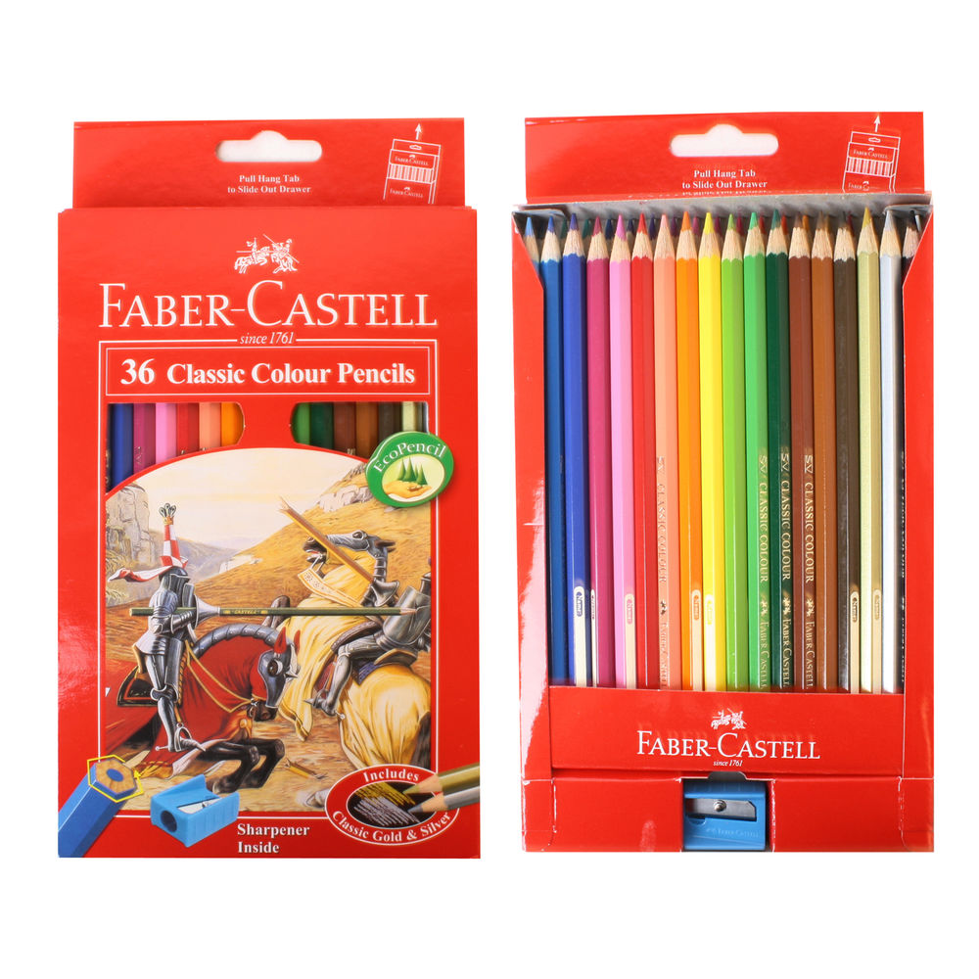
Pachet: exemplu

Slide 7
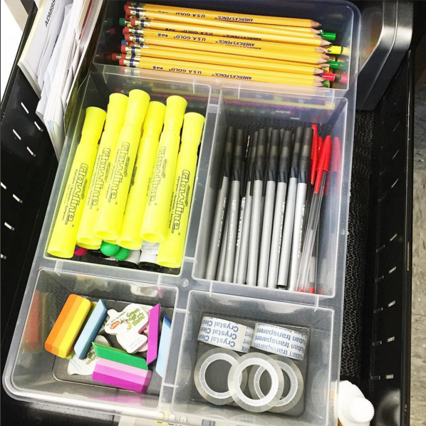
Pachete: exemplu

Slide 8
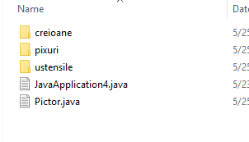
Pachet: exemplu în Java

Slide 9
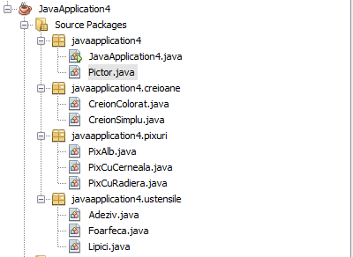
Pachet: exemplu în IDE

Slide 10
Access modifiers:
default
private
protected
public

Slide 11
default
is used when no modifier is used: example: class DefaultAccessClass { int number = 0; int getNumber(){ return number; } }
properties, classes and methods can be declared without any modifiers
Rule: members with default access level can be accessed only by the classes from the same package.
=> default ~ package level

Slide 12
private: the most restrictive
used with keyword private
example: class PrivateAccessClass { private int number = 0; private int getNumber(){ return number; } }
Class cannot be private
Rule: methods, variables, constructors, that are declared private can be only accessed within the class itself.
Variables, declared as private, can be accessed using the public getter methods (if present)
private encapsulates the data from the outside world.

Slide 13
public: the least restrictive
is used when with keyword public: example: public class PublicAccessClass { public int number = 0; public int getNumber(){ return number; } }
Rule: a class, method, constructor, interface, etc. declared public can be accessed from any other class.
Public classes should still be imported in other packages.

Slide 14
protected: package + childs
is used with keywork protected: example: public class ProtectedAccessClass { protected int number = 0; protected int getNumber(){ return number; } }
Class cannot be protected
Rule: Properties, methods, and constructors, which are declared protected in a superclass can be accessed only by the subclasses in other package or any class within the package of the protected members' class.

Slide 15


Subclasă

Slide 16
Subclass
public class IPodShuffle { protected void playMusic(){ // Read music file } protected void stopMusic() { // Stop playback } }
public class IPodNano extends IPodShuffle { // playMusic is accessible as well as stopMusic protected playRadio() { this.stopMusic(); } }

Slide 17
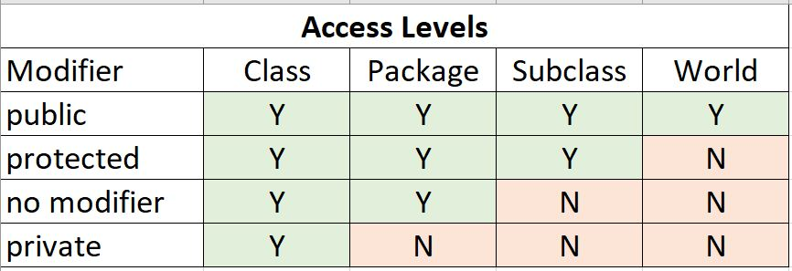
Summary
imagine: Techdemic

Slide 18
Întrebări, sugestii, propuneri

